Slide 1

Career & City Search

Slide 2
Welcome to the Career & City Search page. We are glad you found us!
Are you interested in a career change? Are you looking to relocate to a new city? Are you curious to see how your current city’s average salary, housing prices, and unemployment rate compares to other cities in the United States?
Career & City Search is here to help.
Navigate our site by typing in a specific city or job title into the search bar. The results you get will be high-level information specific to that city or job you are interested in learning more about. You will also find dynamic tableau visualizations that help show how major cities compare to one another in terms of population size, average rent payments and even commute time and average temperatures.
We hope our website helps make your next career and/or city search easy and straightforward.
Happy Searching! -The Career & City Search Team

Slide 3
Tech Jobs USA
City:
Enter a City
Home
Tableau Dashboard
Machine Learning
Static Reports
Top 10 Cities for Data Analysts
Historical unemployment
Housing Data
Useful Links
U.S. Crime map
U.S. News report
or
Job Title:
Enter a Job Title

Slide 4
Tech Jobs USA
City:
De
Home
Tableau Dashboard
Machine Learning
Static Reports
Top 10 Cities for Data Analysts
Historical unemployment
Housing Data
Useful Links
U.S. Crime map
U.S. News report
or
Job Title:
Enter a Job Title
City | State | House Price | Median Rent | Unemployment | Population
Denver | CO | 320,000 | 1,654 | 3.4% | 1,709,928
Des Moines | IA | 235,000 | 1,252 | 3.8% | 1,108,000
Detroit | MI | 210,000 | 1,189 | 4.5% | 1,890,278

Slide 5
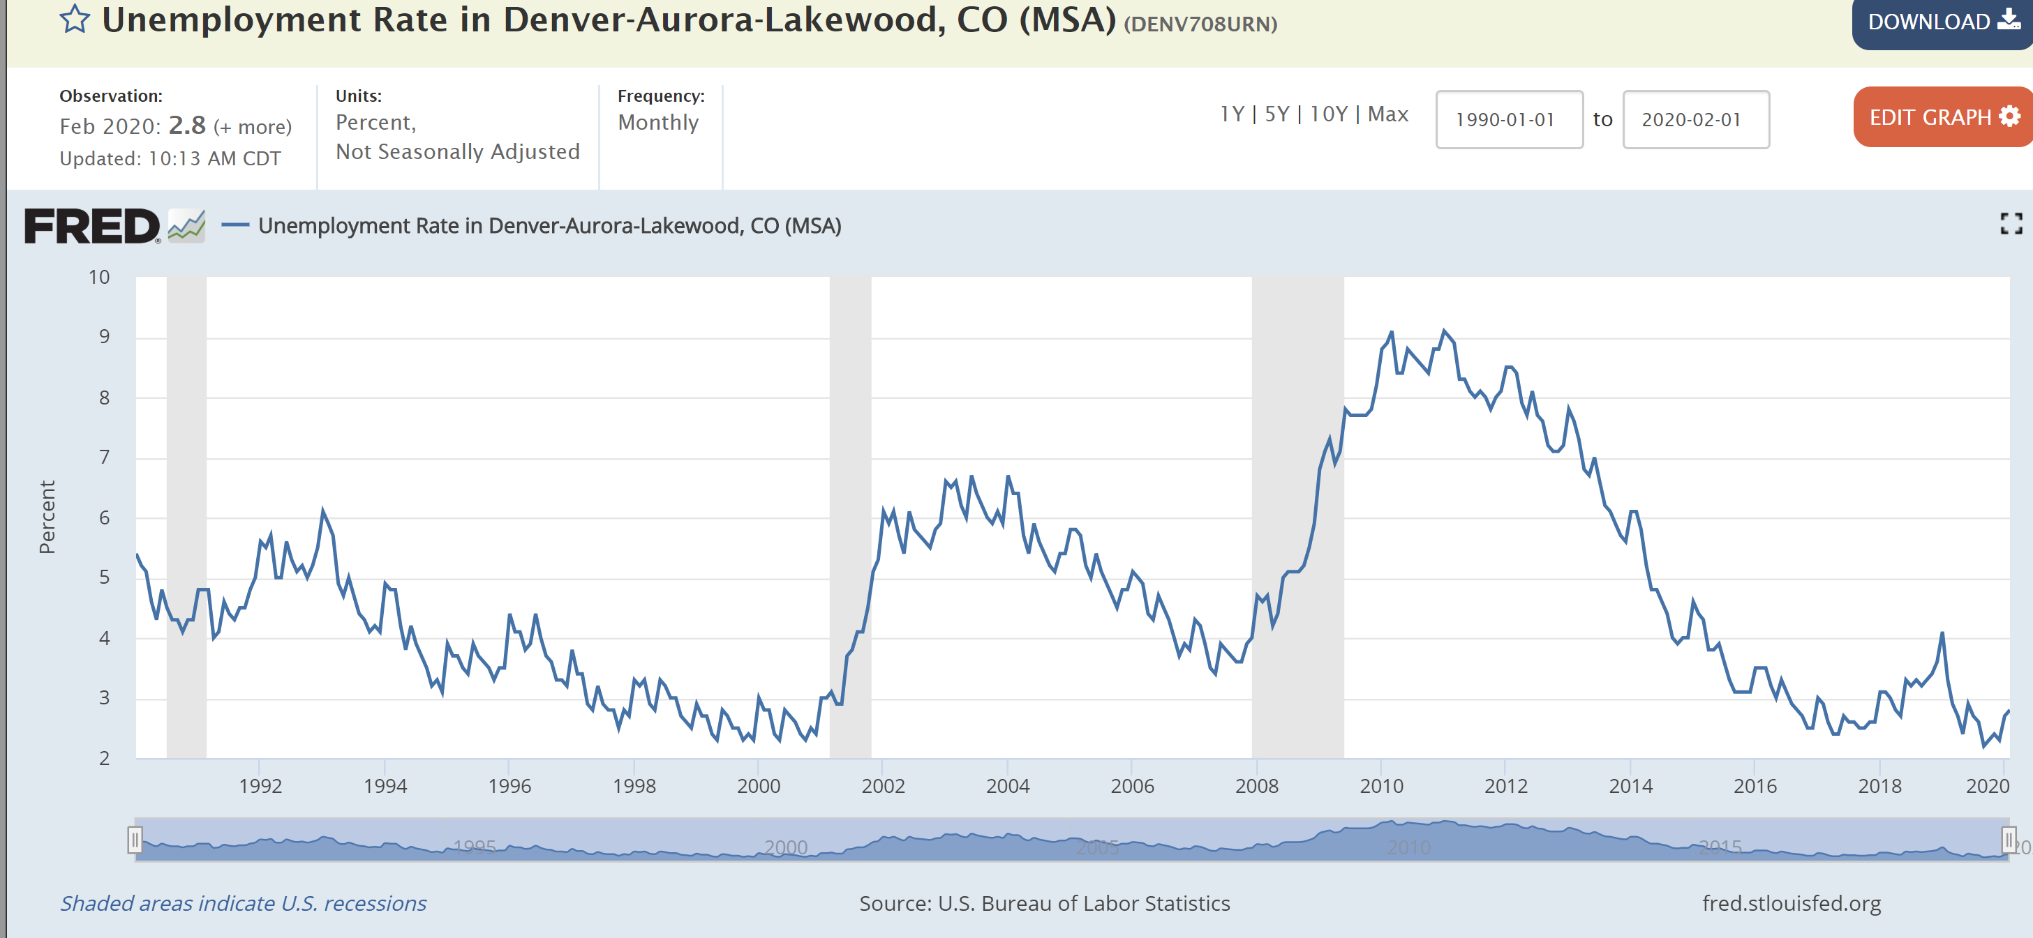
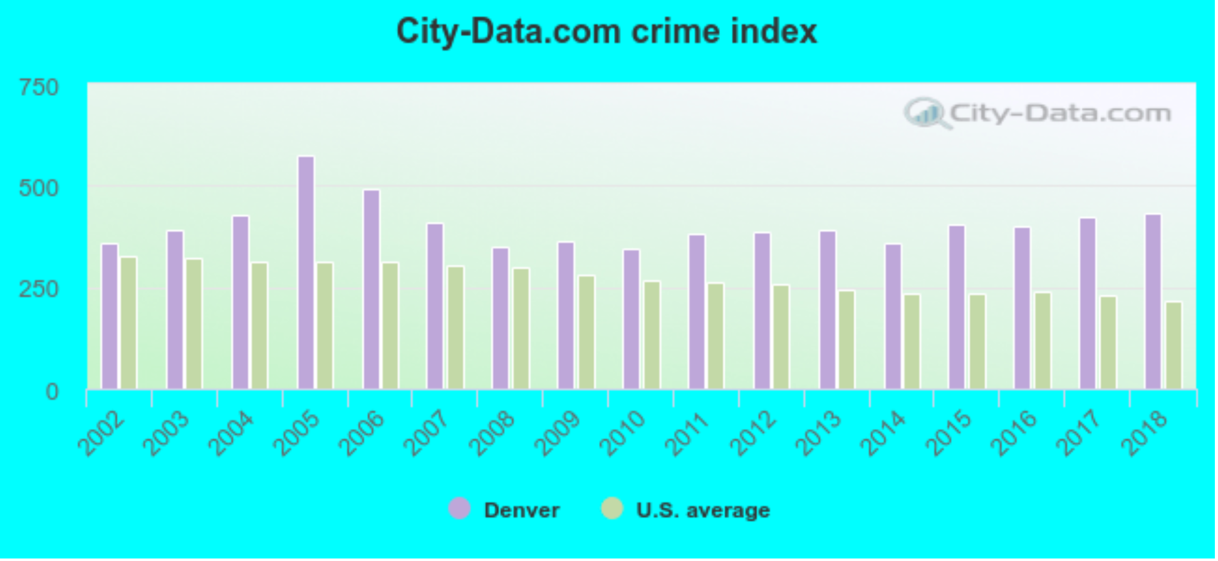
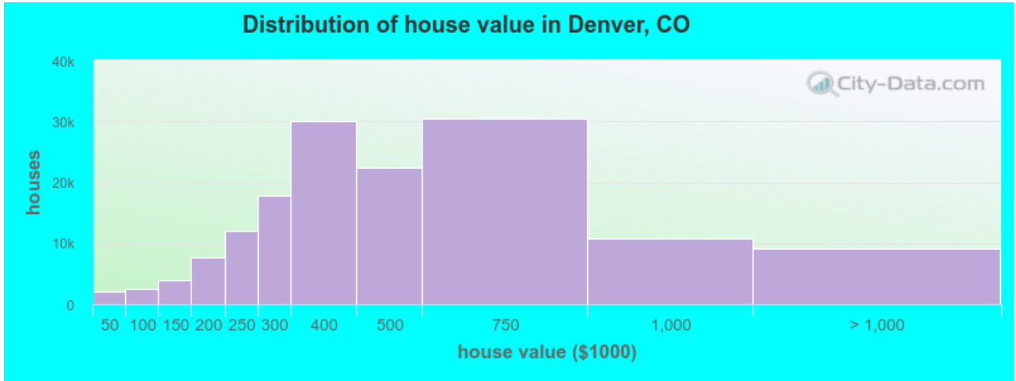
Tech Jobs USA
Denver, CO - Insights
Home
Tableau Dashboard
Machine Learning
Static Reports
Top 10 Cities for Data Analysts
Historical unemployment
Housing Data
Useful Links
U.S. Crime map
U.S. News report
Overall Ranking: #5
Facts and Numbers
Population
678,467
+17.4% since 2010
Unemployment Rate
3.4%
Median Income
$51,800
Median Home Price
$426,200
Median Age
34.4
Comfort Index (Climate)
7.3/10

Slide 6
Tech Jobs USA
City:
Enter a City
Home
Tableau Dashboard
Machine Learning
Static Reports
Top 10 Cities for Data Analysts
Historical unemployment
Housing Data
Useful Links
U.S. Crime map
U.S. News report
or
Job Title:
Data
Job Title | Average Salary | Job Openings
Data Analyst | $78,039 | 3,098
Data Scientist | $156,908 | 4,209
Database Administrator | $89,476 | 2,901

Slide 7
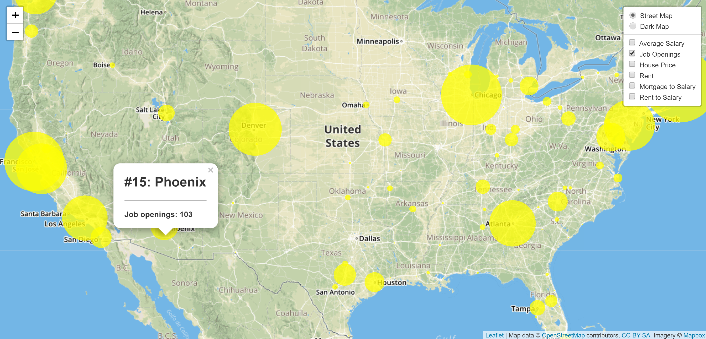
Tech Jobs USA
Data Analyst – Job Openings
Home
Tableau Dashboard
Machine Learning
Static Reports
Top 10 Cities for Data Analysts
Historical unemployment
Housing Data
Useful Links
U.S. Crime map
U.S. News report

Slide 8
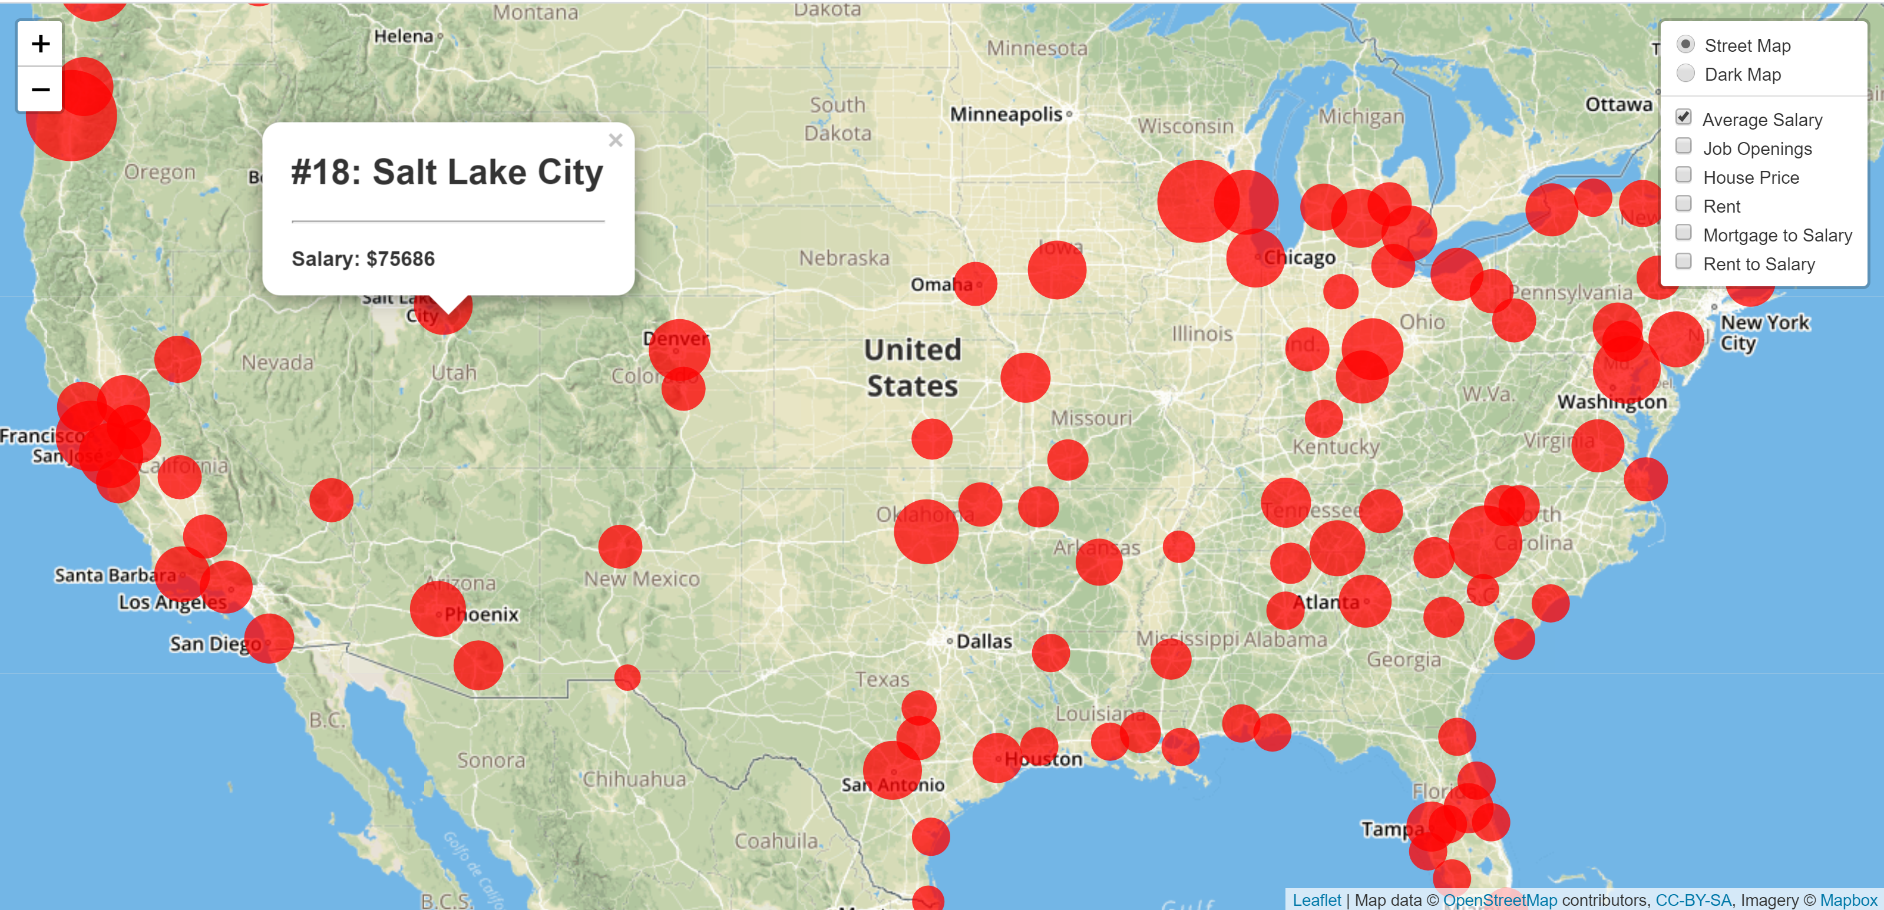
Tech Jobs USA
Data Analyst – Salary
Home
Tableau Dashboard
Machine Learning
Static Reports
Top 10 Cities for Data Analysts
Historical unemployment
Housing Data
Useful Links
U.S. Crime map
U.S. News report

Slide 9
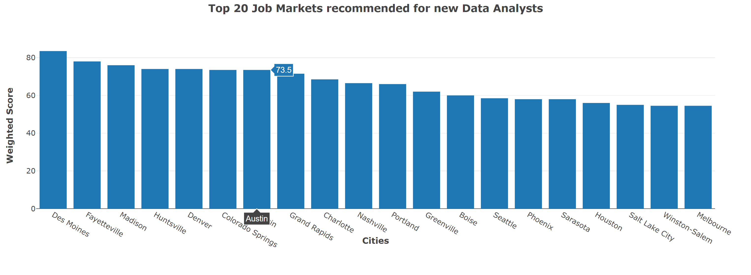
Tech Jobs USA
Data Analyst – Overall Rankings
Home
Tableau Dashboard
Machine Learning
Static Reports
Top 10 Cities for Data Analysts
Historical unemployment
Housing Data
Useful Links
U.S. Crime map
U.S. News report

